Slide 1

Chapter 10
Error Detection
and
Correction
10.<number>
Copyright © The McGraw-Hill Companies, Inc. Permission required for reproduction or display.

Slide 2

Note
Data can be corrupted
during transmission.
Some applications require that
errors be detected and corrected.
10.<number>

Slide 3
10-1 INTRODUCTION
Let us first discuss some issues related, directly or indirectly, to error detection and correction.
Topics discussed in this section:
Types of Errors
Redundancy
Detection Versus Correction
Forward Error Correction Versus Retransmission
Coding
Modular Arithmetic
10.<number>

Slide 4
Note
In a single-bit error, only 1 bit in the data unit has changed.
10.<number>

Slide 5

Figure 10.1 Single-bit error
10.<number>

Slide 6
Note
A burst error means that 2 or more bits in the data unit have changed.
10.<number>

Slide 7

Figure 10.2 Burst error of length 8
10.<number>

Slide 8
Note
To detect or correct errors, we need to send extra (redundant) bits with data.
10.<number>

Slide 9

Figure 10.3 The structure of encoder and decoder
10.<number>

Slide 10
Note
In modulo-N arithmetic, we use only the integers in the range 0 to N −1, inclusive.
10.<number>

Slide 11

Figure 10.4 XORing of two single bits or two words
10.<number>

Slide 12
10-2 BLOCK CODING
In block coding, we divide our message into blocks, each of k bits, called datawords. We add r redundant bits to each block to make the length n = k + r. The resulting n-bit blocks are called codewords.
Topics discussed in this section:
Error Detection
Error Correction
Hamming Distance
Minimum Hamming Distance
10.<number>

Slide 13

Figure 10.5 Datawords and codewords in block coding
10.<number>

Slide 14
Example 10.1
In this coding scheme,
k = 4 and n = 5. As we saw, we have 2^{k} = 16 datawords and 2^{n} = 32 codewords. We saw that 16 out of 32 codewords are used for message transfer and the rest are either used for other purposes or unused.
10.<number>

Slide 15

Figure 10.6 Process of ERROR DETECTION in block coding
10.<number>

Slide 16

Example 10.2
Let us assume that k = 2 and n = 3. Table 10.1 shows the list of datawords and codewords. Later, we will see how to derive a codeword from a dataword.
Assume the sender encodes the dataword 01 as 011 and
sends it to the receiver. Consider the following cases:
1. The receiver receives 011. It is a valid codeword. The
receiver extracts the dataword 01 from it.
10.<number>

Slide 17
Example 10.2 (continued)
2. The codeword is corrupted during transmission, and
111 is received. This is not a valid codeword and is
discarded.
3. The codeword is corrupted during transmission, and
000 is received. This is a valid codeword. The receiver
incorrectly extracts the dataword 00. Two corrupted
bits have made the error undetectable.
10.<number>

Slide 18
Note
An error-detecting code can detect
only the types of errors for which it is designed; other types of errors may remain undetected.
10.<number>

Slide 19

Figure 10.7 Structure of encoder and decoder in error correction
10.<number>

Slide 20
Example 10.3
Let us add more redundant bits to Example 10.2 to see if the receiver can correct an error without knowing what was actually sent. We add 3 redundant bits to the 2-bit dataword to make 5-bit codewords. Table 10.2 shows the datawords and codewords. Assume the dataword is 01. The sender creates the codeword 01011. The codeword is corrupted during transmission, and 01001 is received. First, the receiver finds that the received codeword is not in the table. This means an error has occurred. The receiver, assuming that there is only 1 bit corrupted, uses the following strategy to guess the correct dataword.
10.<number>

Slide 21
Example 10.3 (continued)
1. Comparing the received codeword with the first codeword in the table (01001 versus 00000), the receiver decides that the first codeword is not the one that was sent because there are two different bits.
2. By the same reasoning, the original codeword cannot be the third or fourth one in the table.
3. The original codeword must be the second one in the table because this is the only one that differs from the received codeword by 1 bit. The receiver replaces 01001 with 01011 and consults the table to find the dataword 01.
10.<number>

Slide 22

Table 10.2 A code for error correction (Example 10.3)
10.<number>

Slide 23
Note
The Hamming distance between two words is the number of differences between corresponding bits.
10.<number>

Slide 24

Example 10.4
Let us find the Hamming distance between two pairs of words.
1. The Hamming distance d(000, 011) is 2 because
2. The Hamming distance d(10101, 11110) is 3 because
10.<number>

Slide 25
Note
The minimum Hamming distance is the smallest Hamming distance between
all possible pairs in a set of words.
10.<number>

Slide 26
Example 10.5
Find the minimum Hamming distance of the coding scheme in Table 10.1.
Solution
We first find all Hamming distances.
The d_{min} in this case is 2.
10.<number>

Slide 27
Example 10.6
Find the minimum Hamming distance of the coding scheme in Table 10.2.
Solution
We first find all the Hamming distances.
The d_{min} in this case is 3.
10.<number>

Slide 28
Note
To guarantee the detection of up to s errors in all cases, the minimum
Hamming distance in a block
code must be d_{min} = s + 1.
10.<number>

Slide 29
Example 10.7
The minimum Hamming distance for our first code scheme (Table 10.1) is 2. This code guarantees detection of only a single error. For example, if the third codeword (101) is sent and one error occurs, the received codeword does not match any valid codeword. If two errors occur, however, the received codeword may match a valid codeword and the errors are not detected.
10.<number>

Slide 30
Example 10.8
Our second block code scheme (Table 10.2) has d_{min} = 3. This code can detect up to two errors. Again, we see that when any of the valid codewords is sent, two errors create a codeword which is not in the table of valid codewords.
However, some combinations of three errors change a valid codeword to another valid codeword. The receiver accepts the received codeword and the errors are undetected.
10.<number>

Slide 31

Figure 10.8 Geometric concept for finding d_{min} in error detection
10.<number>

Slide 32

Figure 10.9 Geometric concept for finding d_{min} in error correction
10.<number>

Slide 33
Note
To guarantee correction of up to t errors in all cases, the minimum Hamming distance in a block code
must be d_{min} = 2t + 1.
10.<number>

Slide 34
Example 10.9
A code scheme has a Hamming distance d_{min} = 4. What is the error detection and correction capability of this scheme?
Solution
This code guarantees the detection of up to three errors
(s = 3), but it can correct up to one error. In other words,
if this code is used for error correction, part of its capability is wasted. Error correction codes need to have an odd minimum distance (3, 5, 7, . . . ).
10.<number>

Slide 35
10-3 LINEAR BLOCK CODES
Almost all block codes used today belong to a subset called linear block codes. A linear block code is a code in which the exclusive OR (addition modulo-2) of two valid codewords creates another valid codeword.
Topics discussed in this section:
Minimum Distance for Linear Block Codes
Some Linear Block Codes
10.<number>

Slide 36
Note
In a linear block code, the exclusive OR (XOR) of any two valid codewords creates another valid codeword.
10.<number>

Slide 37
Example 10.10
Let us see if the two codes we defined in Table 10.1 and Table 10.2 belong to the class of linear block codes.
1. The scheme in Table 10.1 is a linear block code
because the result of XORing any codeword with any
other codeword is a valid codeword. For example, the
XORing of the second and third codewords creates the
fourth one.
2. The scheme in Table 10.2 is also a linear block code.
We can create all four codewords by XORing two
other codewords.
10.<number>

Slide 38
Example 10.11
In our first code (Table 10.1), the numbers of 1s in the nonzero codewords are 2, 2, and 2. So the minimum Hamming distance is d_{min} = 2. In our second code (Table 10.2), the numbers of 1s in the nonzero codewords are 3, 3, and 4. So in this code we have d_{min} = 3.
10.<number>

Slide 39
Note
A simple parity-check code is a
single-bit error-detecting
code in which
n = k + 1 with d_{min} = 2.
10.<number>

Slide 40
Error-Detecting Codes (1)
Linear, systematic block codes
Parity.
Checksums.
Cyclic Redundancy Checks (CRCs).

Slide 41

Parity Check Codes
Simple parity-check code C(5, 4)

Slide 42

Encoder and decoder for simple parity-check code

Slide 43
Example 10.12
Assume the sender sends the dataword 1011. The codeword created from this dataword is 10111, which is sent to the receiver. We examine five cases:
No error occurs; the received codeword is 10111. The syndrome is 0. The dataword 1011 is created.
One single-bit error changes a₁ . The received
codeword is 10011. The syndrome is 1. No dataword is created.
3. One single-bit error changes r₀ . The received codeword is 10110. The syndrome is 1. No dataword is created.

Slide 44
Example 10.12 (continued)
4. An error changes r₀ and a second error changes a₃ .
The received codeword is 00110. The syndrome is 0. The dataword 0011 is created at the receiver. Note that here the dataword is wrongly created due to the syndrome value.
5. Three bits—a₃, a₂, and a₁—are changed by errors. The received codeword is 01011. The syndrome is 1.The dataword is not created.
This shows that the simple parity check, guaranteed to detect one single error, can also find any odd number of errors.

Slide 45
Vertical Redundancy Check
Vertical Redundancy Check (VRC)
  Append a single bit at the end of data block such that the number of ones is even
  → Even Parity (odd parity is similar)
  0110011 → 01100110
  0110001 → 01100011
  VRC is also known as Parity Check
  Performance:
    Detects all odd-number errors in a data block

Slide 46
Longitudinal Redundancy Check
Longitudinal Redundancy Check (LRC)
  Organize data into a table and create a parity for each column
11100111 11011101 00111001 10101001
11100111
11011101
00111001
10101001
10101010
11100111 11011101 00111001 10101001 10101010
Original Data
LRC
    Detects all burst errors up to length n (number of columns)
    If two bits in one data unit are damaged and two bits in exactly same position in another data unit are also damaged, the LRC checker will not detect the errors.

Slide 47
Check Sum
For example, if the set of numbers is (7, 11, 12, 0, 6), we send (7, 11, 12, 0, 6, 36), where 36 is the sum of the original numbers.
we send (7, 11, 12, 0, 6, −36). The receiver can add all the numbers received (including the checksum). If the result is 0, it assumes no error; otherwise, there is an error.
one’s complement arithmetic using only four bits

Slide 48
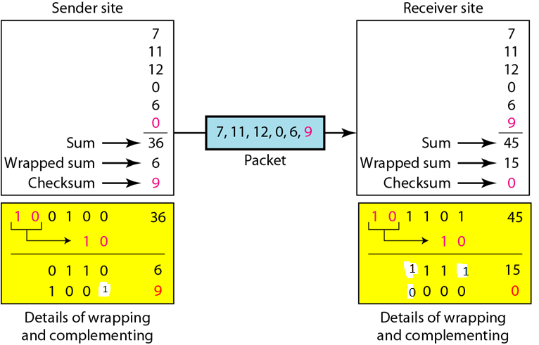

Slide 49
CYCLIC CODES
Cyclic codes are special linear block codes with one extra property.
In a cyclic code, if a codeword is cyclically shifted (rotated), the result is another codeword.

Slide 50

A CRC code with C(7, 4)

Slide 51

CRC encoder and decoder

Slide 52

Division in CRC encoder

Slide 53

Division in the CRC decoder for two cases

Slide 54

A polynomial to represent a binary word

Slide 55

CRC division using polynomials

Slide 56
Error Correction Codes (1)
Hamming codes.
Binary convolutional codes.
Reed-Solomon codes.
Low-Density Parity Check codes.

Slide 57

Hamming code C(7, 4)

Slide 58

The structure of the encoder and decoder for a Hamming code

Slide 59
Create the data word, leaving spaces for the parity bits: _ _ 1 _ 0 0 1 _ 1 0 1 0
Position 1 checks bits 1,3,5,7,9,11:
? _ 1 _ 0 0 1 _ 1 0 1 0. Even parity so set position 1 to a 0: 0 _ 1 _ 0 0 1 _ 1 0 1 0
Position 2 checks bits 2,3,6,7,10,11:
0 ? 1 _ 0 0 1 _ 1 0 1 0. Odd parity so set position 2 to a 1: 0 1 1 _ 0 0 1 _ 1 0 1 0
Position 4 checks bits 4,5,6,7,12:
0 1 1 ? 0 0 1 _ 1 0 1 0. Odd parity so set position 4 to a 1: 0 1 1 1 0 0 1 _ 1 0 1 0
Position 8 checks bits 8,9,10,11,12:
0 1 1 1 0 0 1 ? 1 0 1 0. Even parity so set position 8 to a 0: 0 1 1 1 0 0 1 0 1 0 1 0

Slide 60
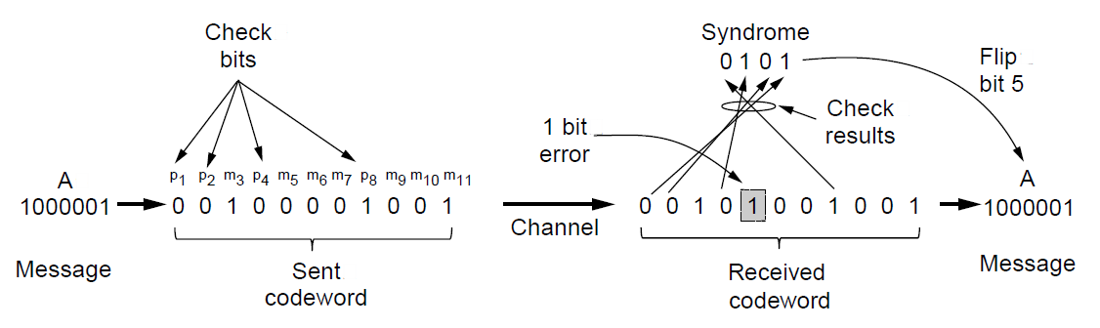
Error Detection Codes (2)
Example of an (11, 7) Hamming code
correcting a single-bit error.

